Slide 1
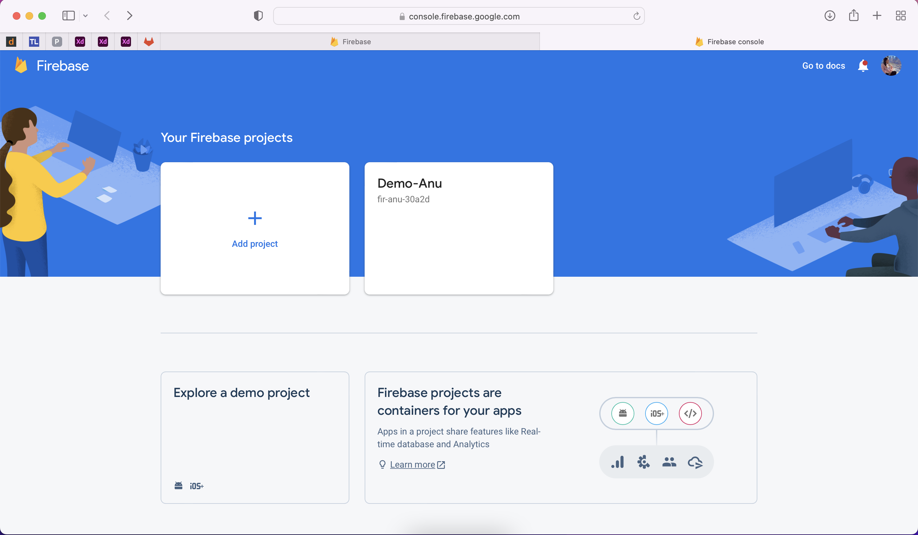
.
Go to firebase console: https://console.firebase.google.com/u/1
Click on Add button to create new project

Slide 2
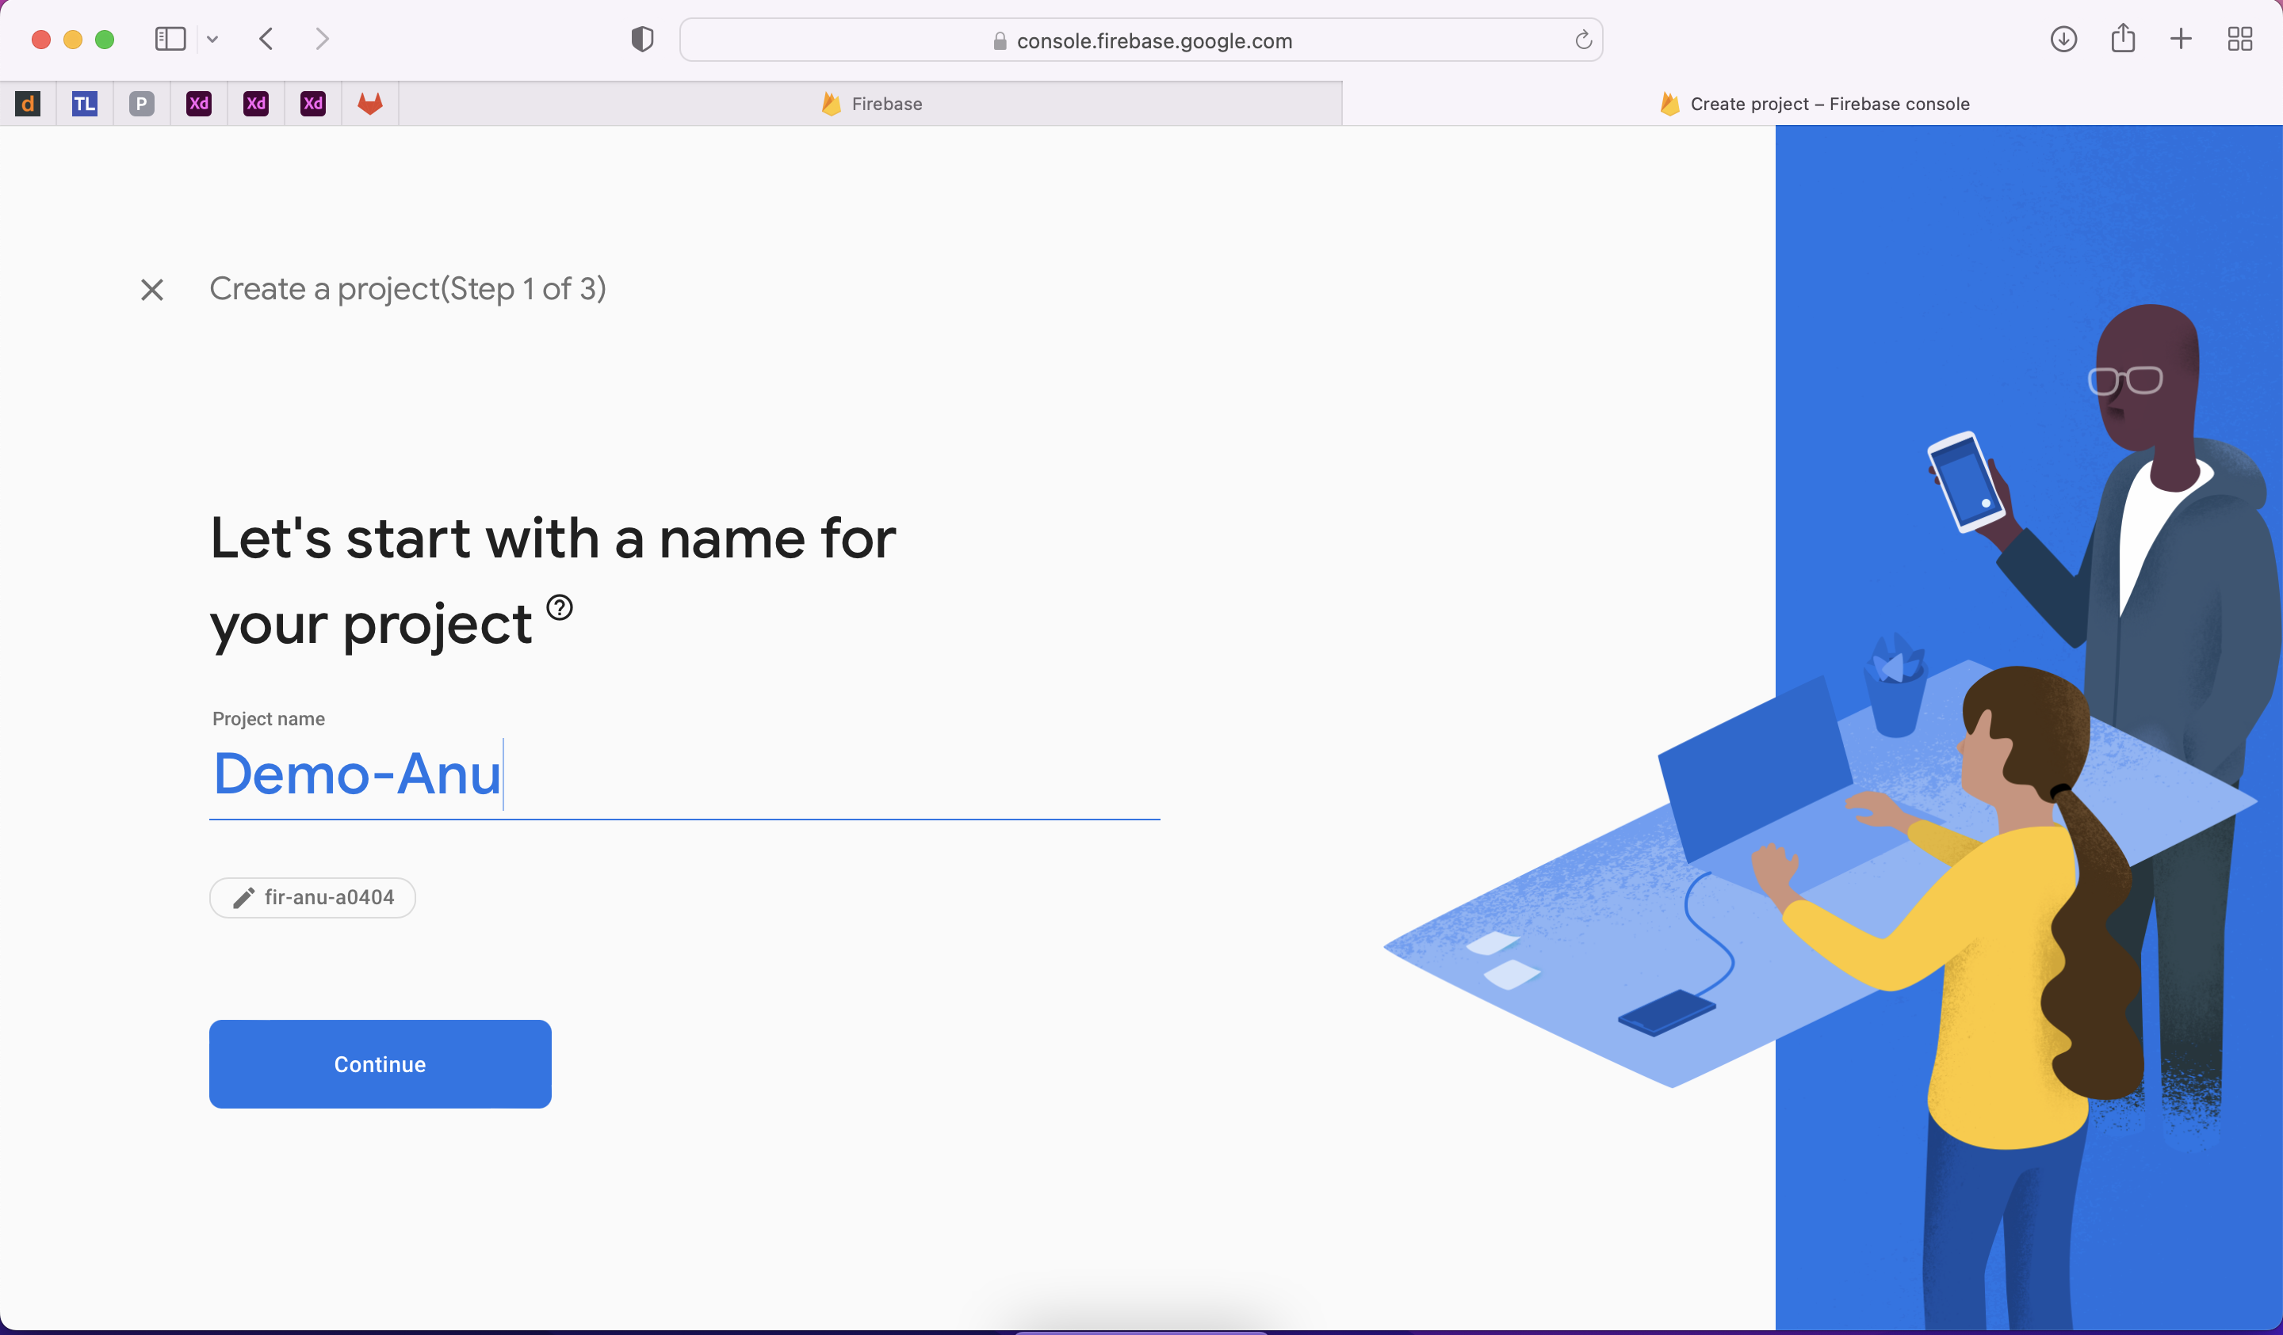
Enter Name of the project

Slide 3
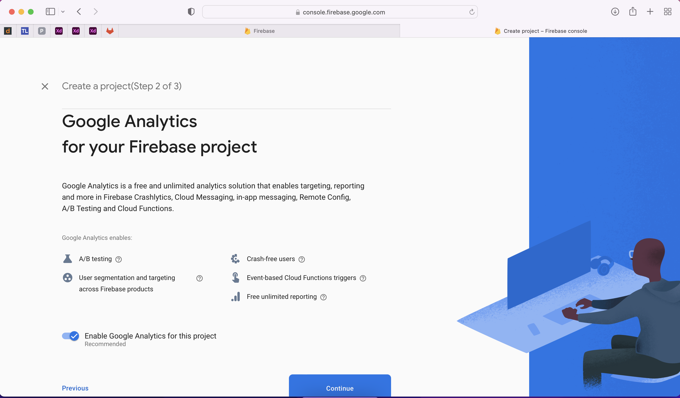
Google analytics provides following services
1. A/B Testing
2. Crash analytics
3. App reporting

Slide 4
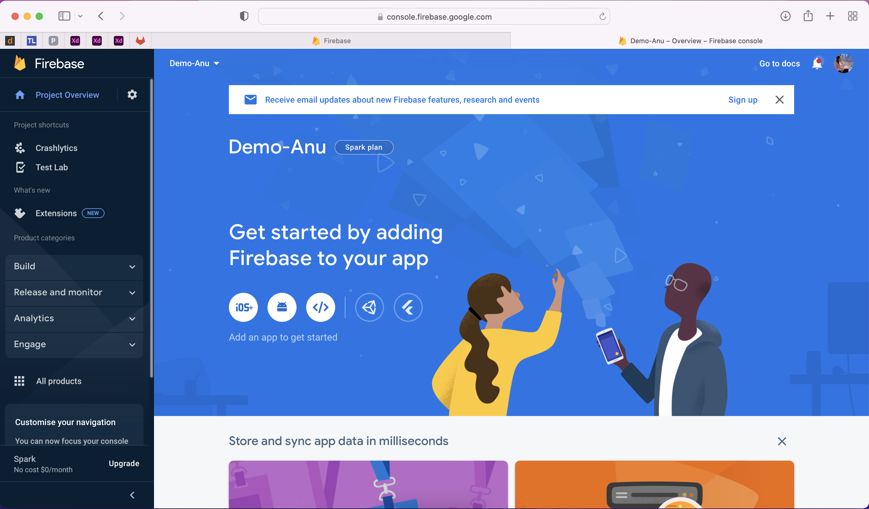
After created the project user goto User dashboard and click on “Test lab” on the left side of drawer

Slide 5
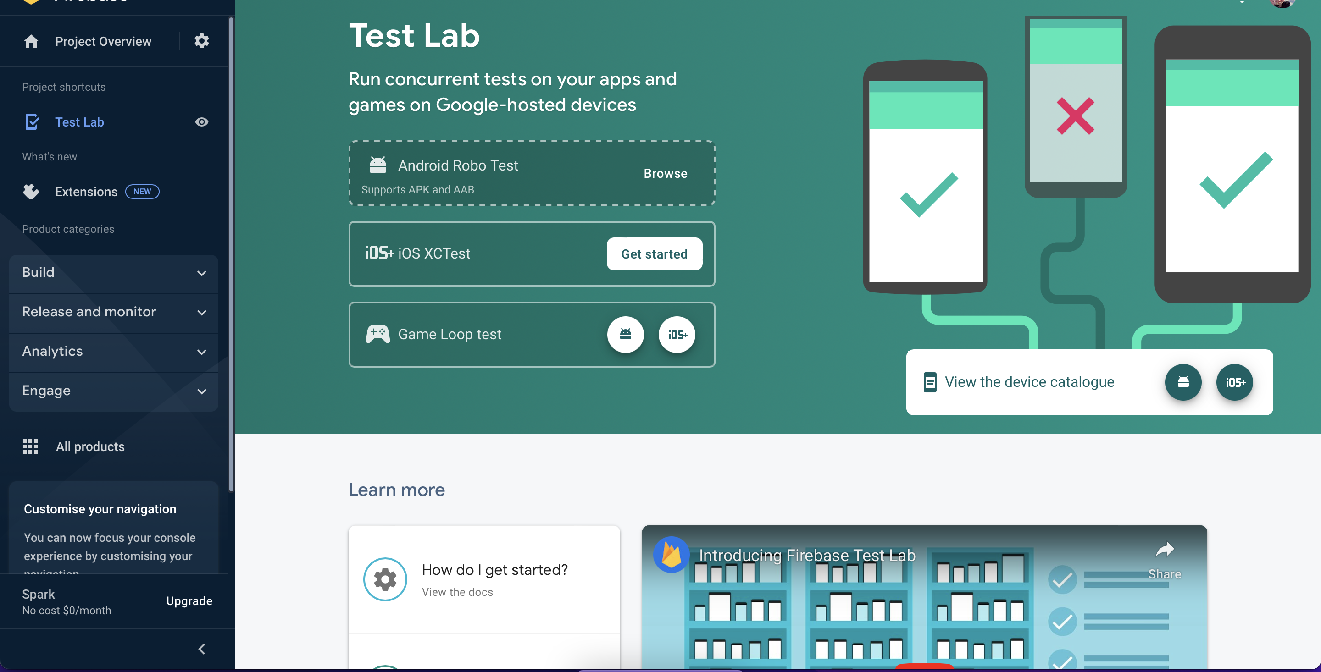
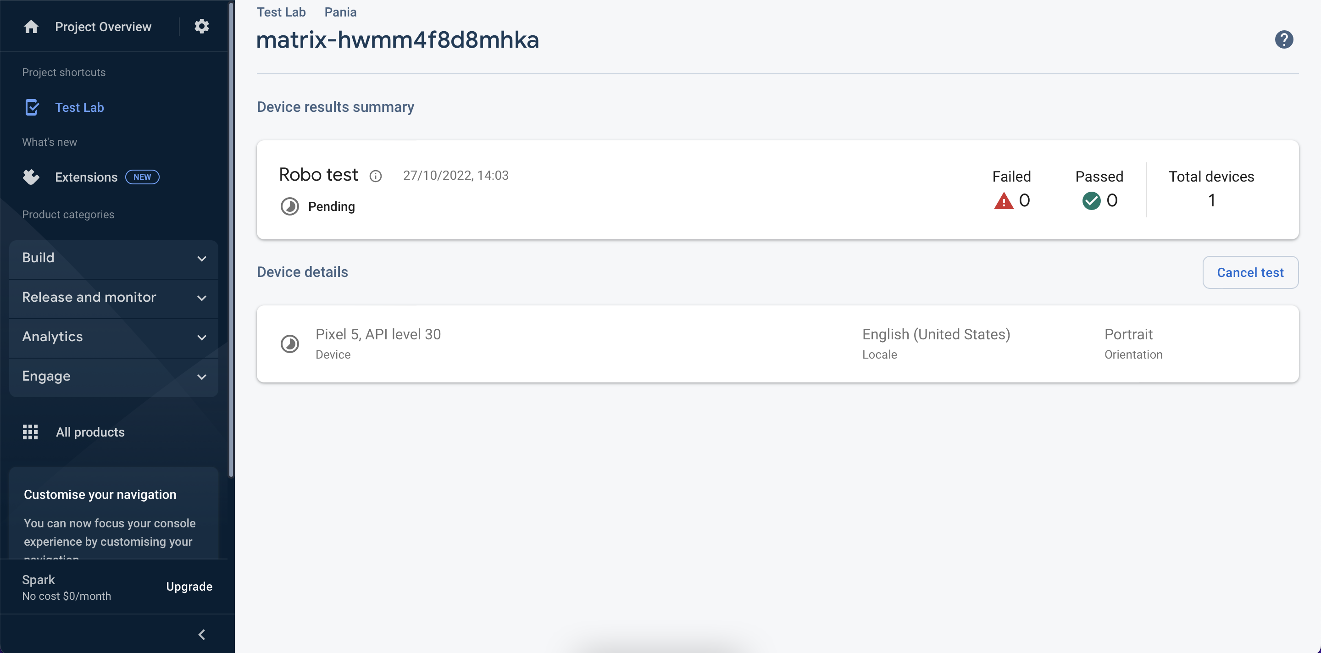
You can test project with uploading .APK(Android), .IPA(iOS)

Slide 6
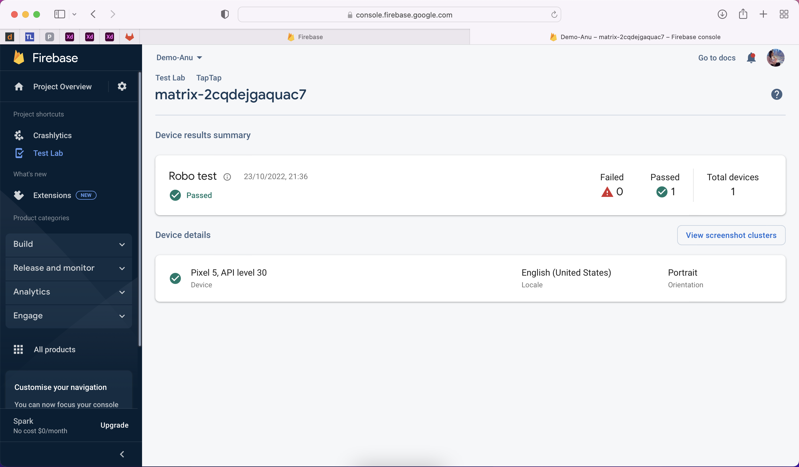
Testing Completetd with “Passed”

Slide 7
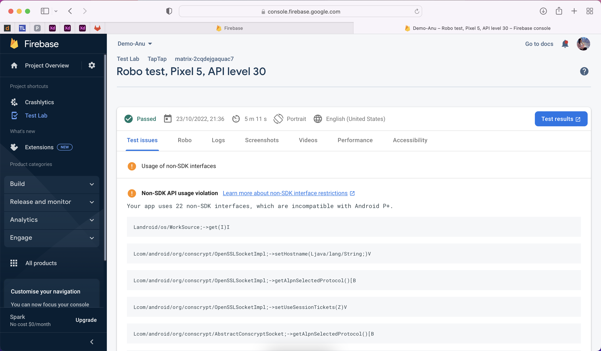
Testing Issues

Slide 8
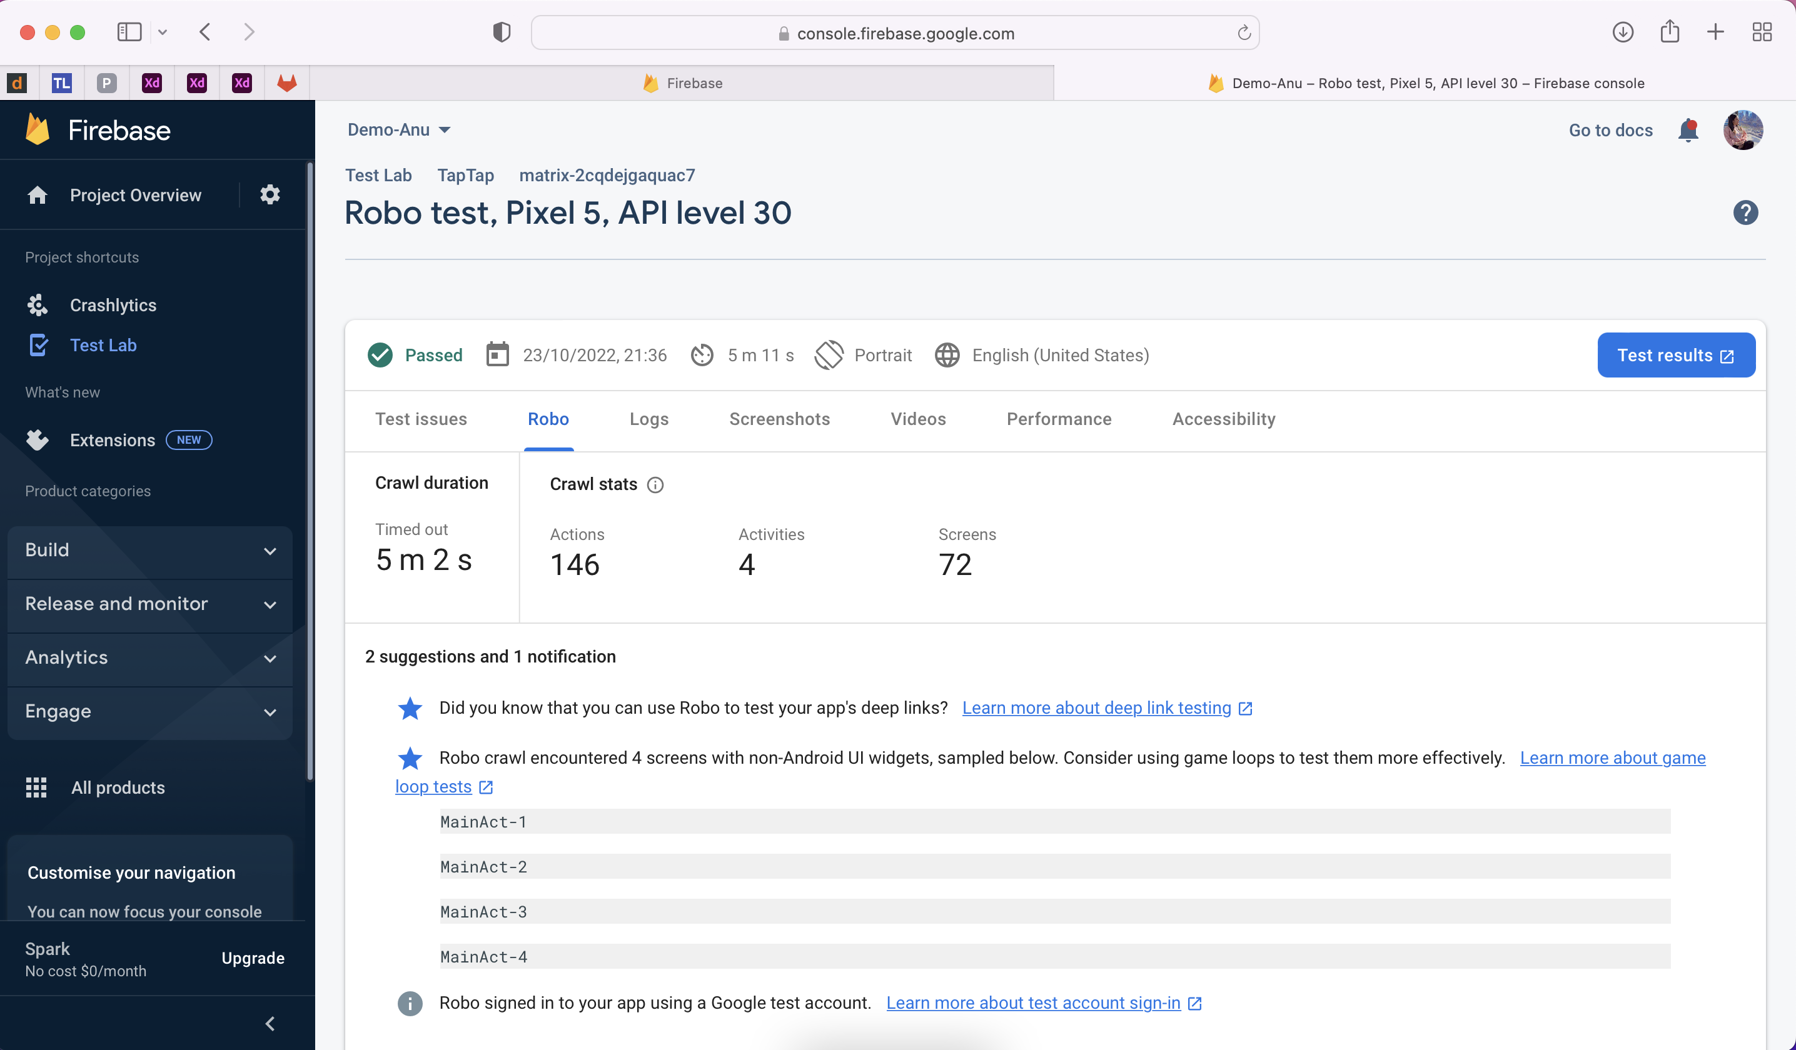
Robo

Slide 9
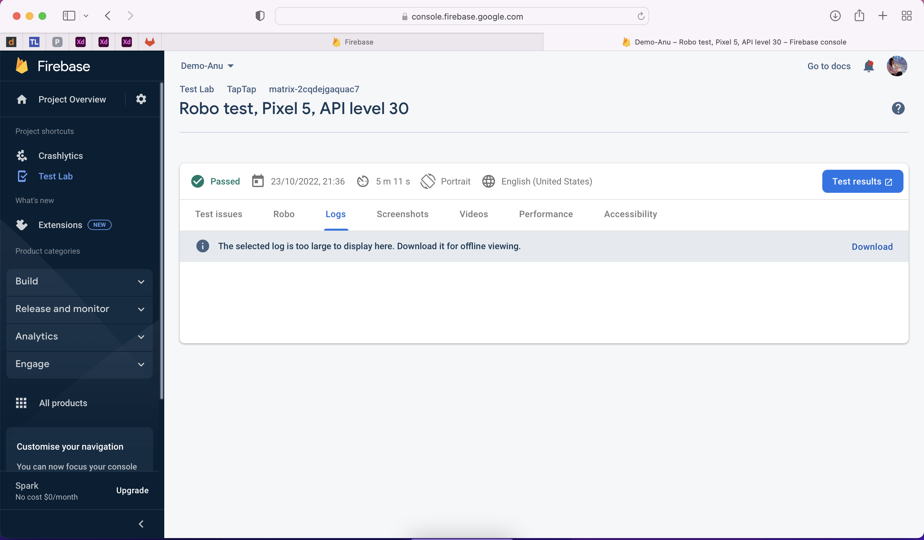
Project Logs

Slide 10
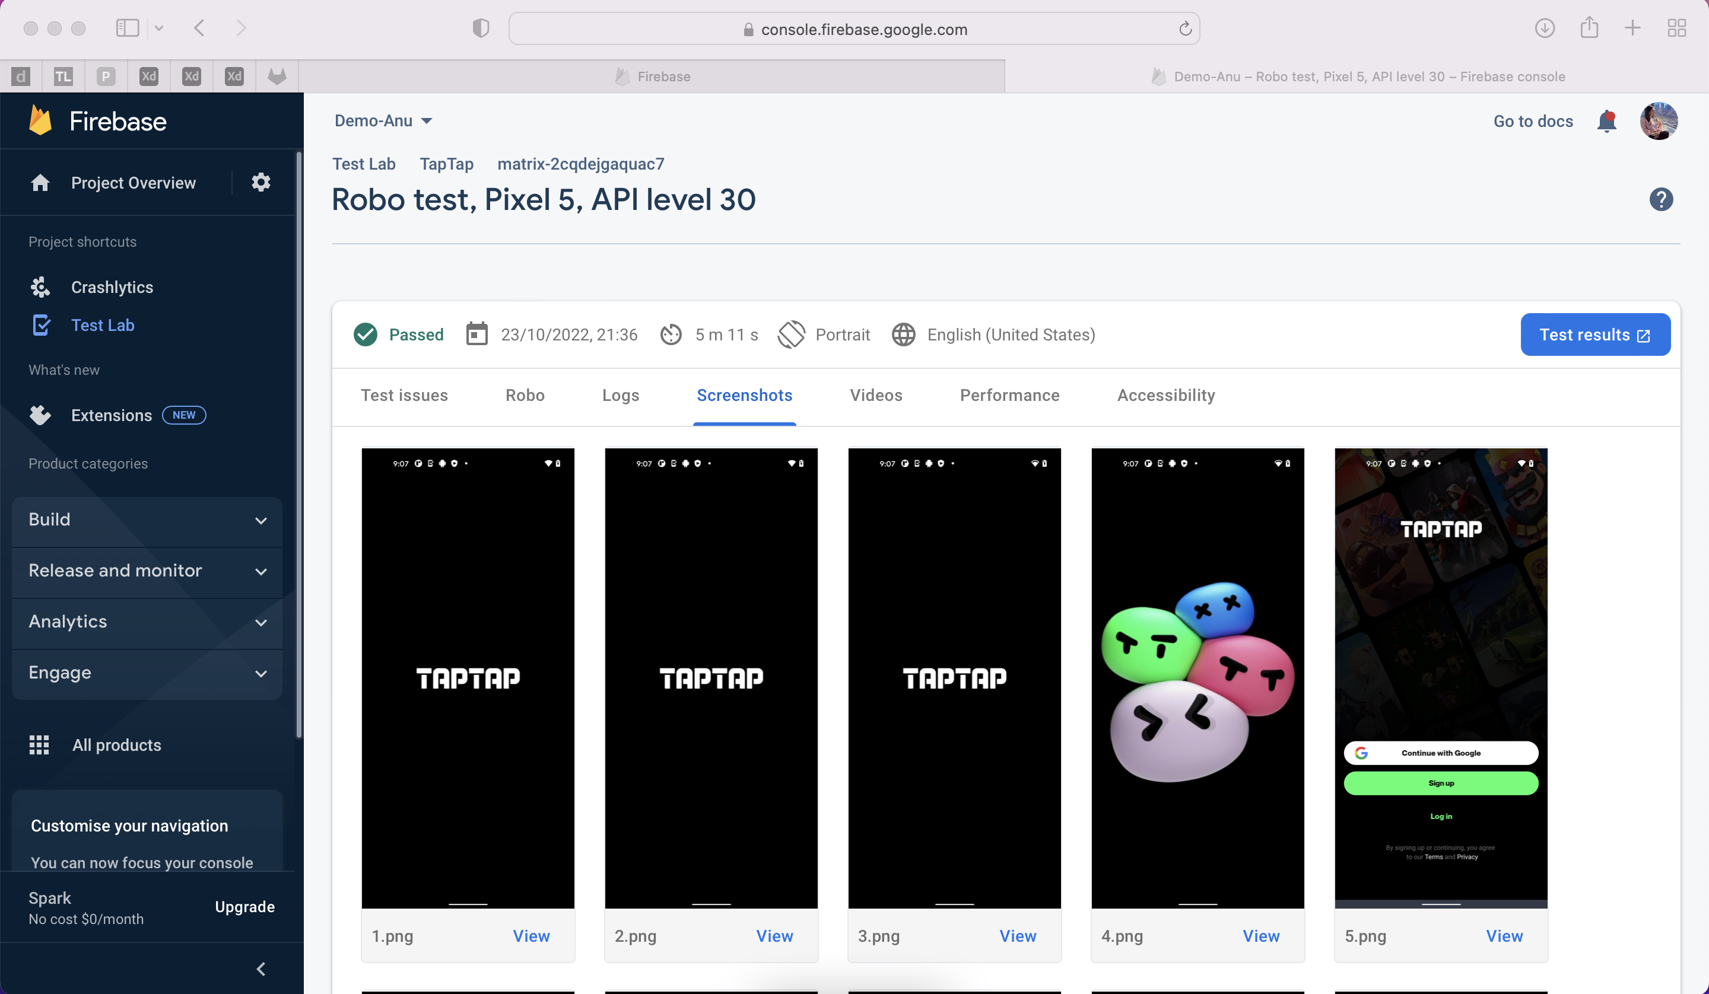
Project Screen shots

Slide 11
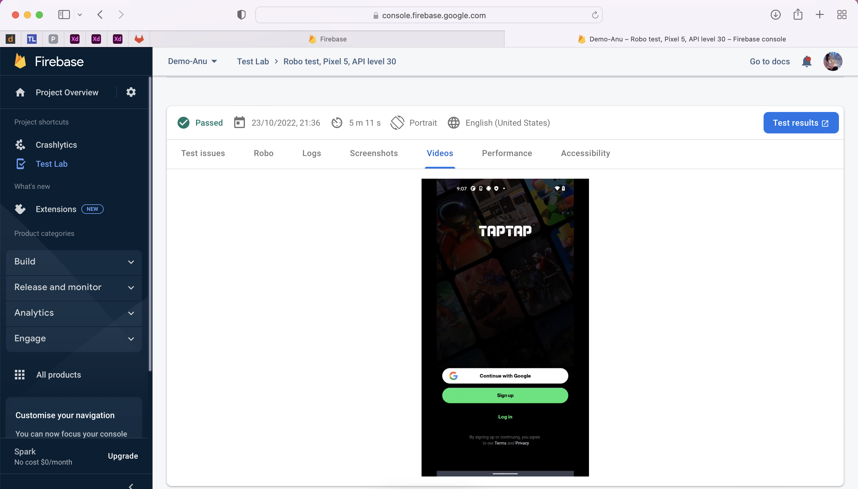
Project Videos

Slide 12
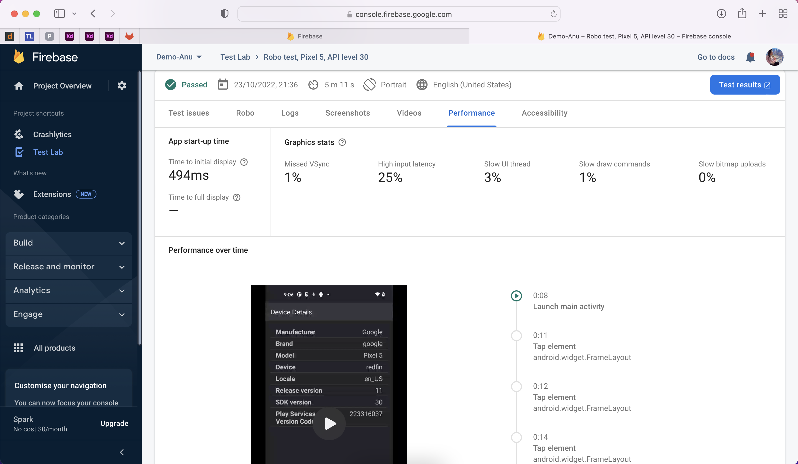
Project Performance

Slide 13
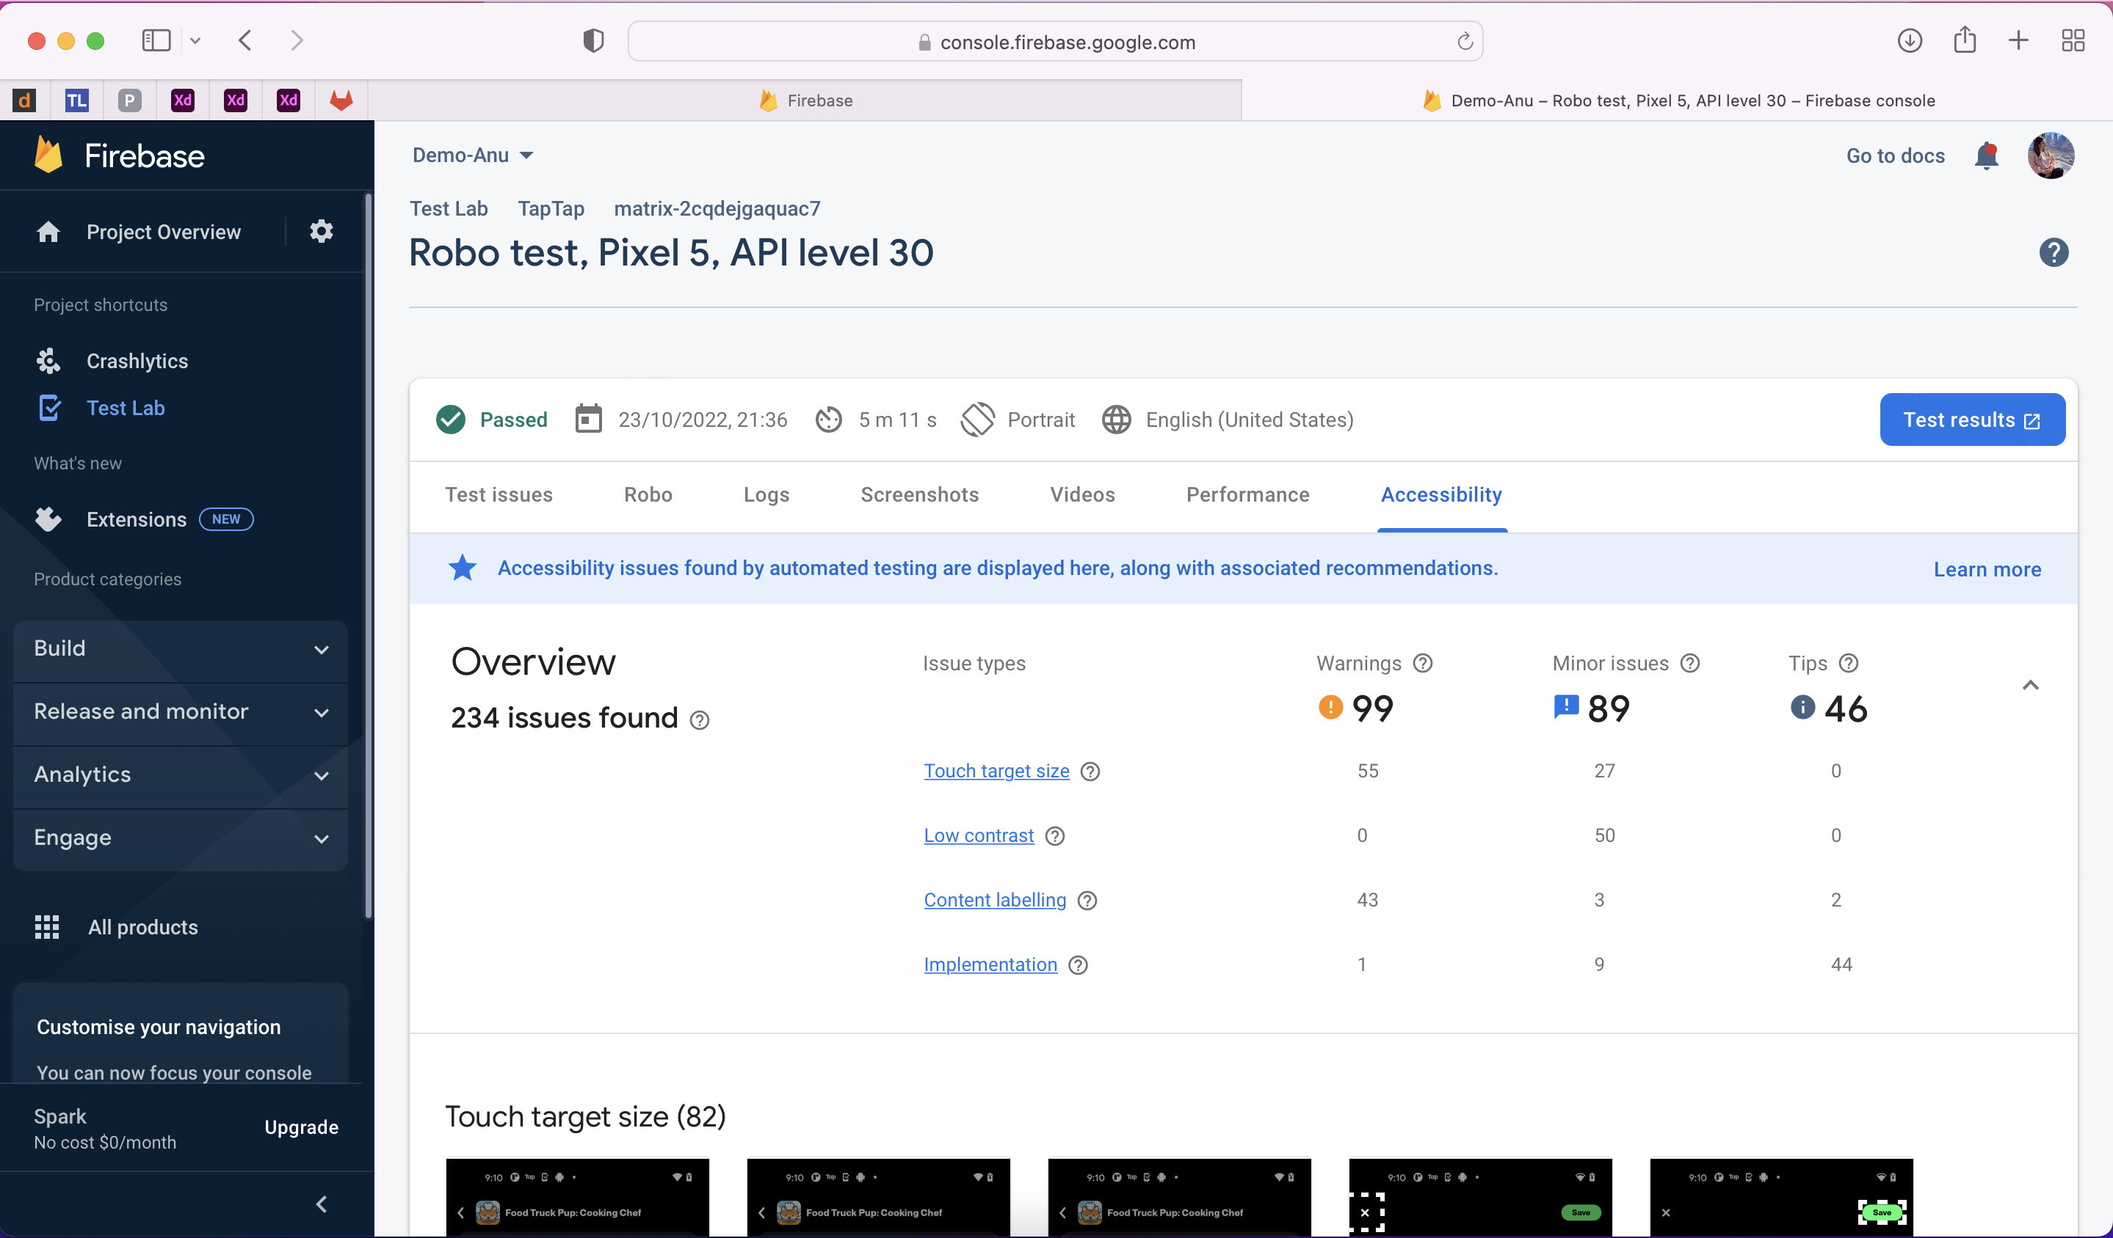
Project Accessibility

Slide 14
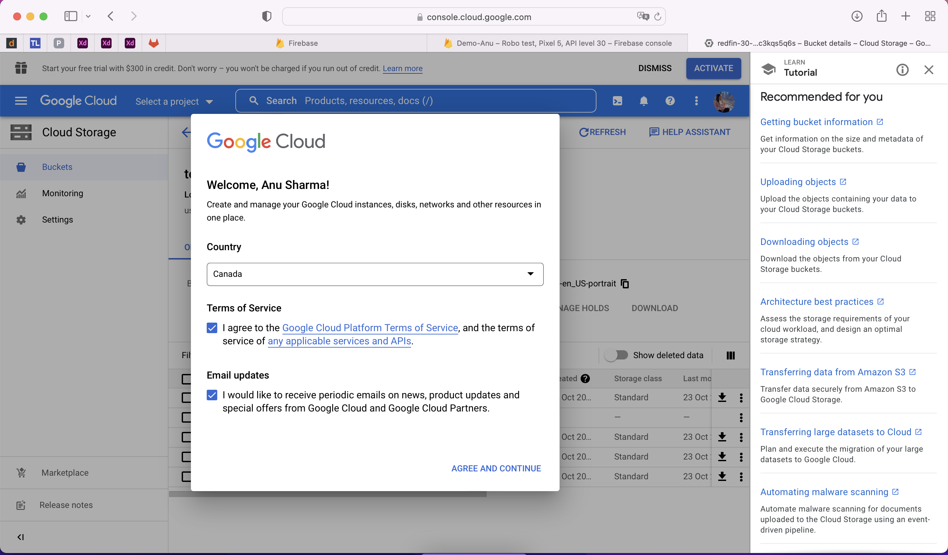
Cloud Storage(Data base)

Slide 15
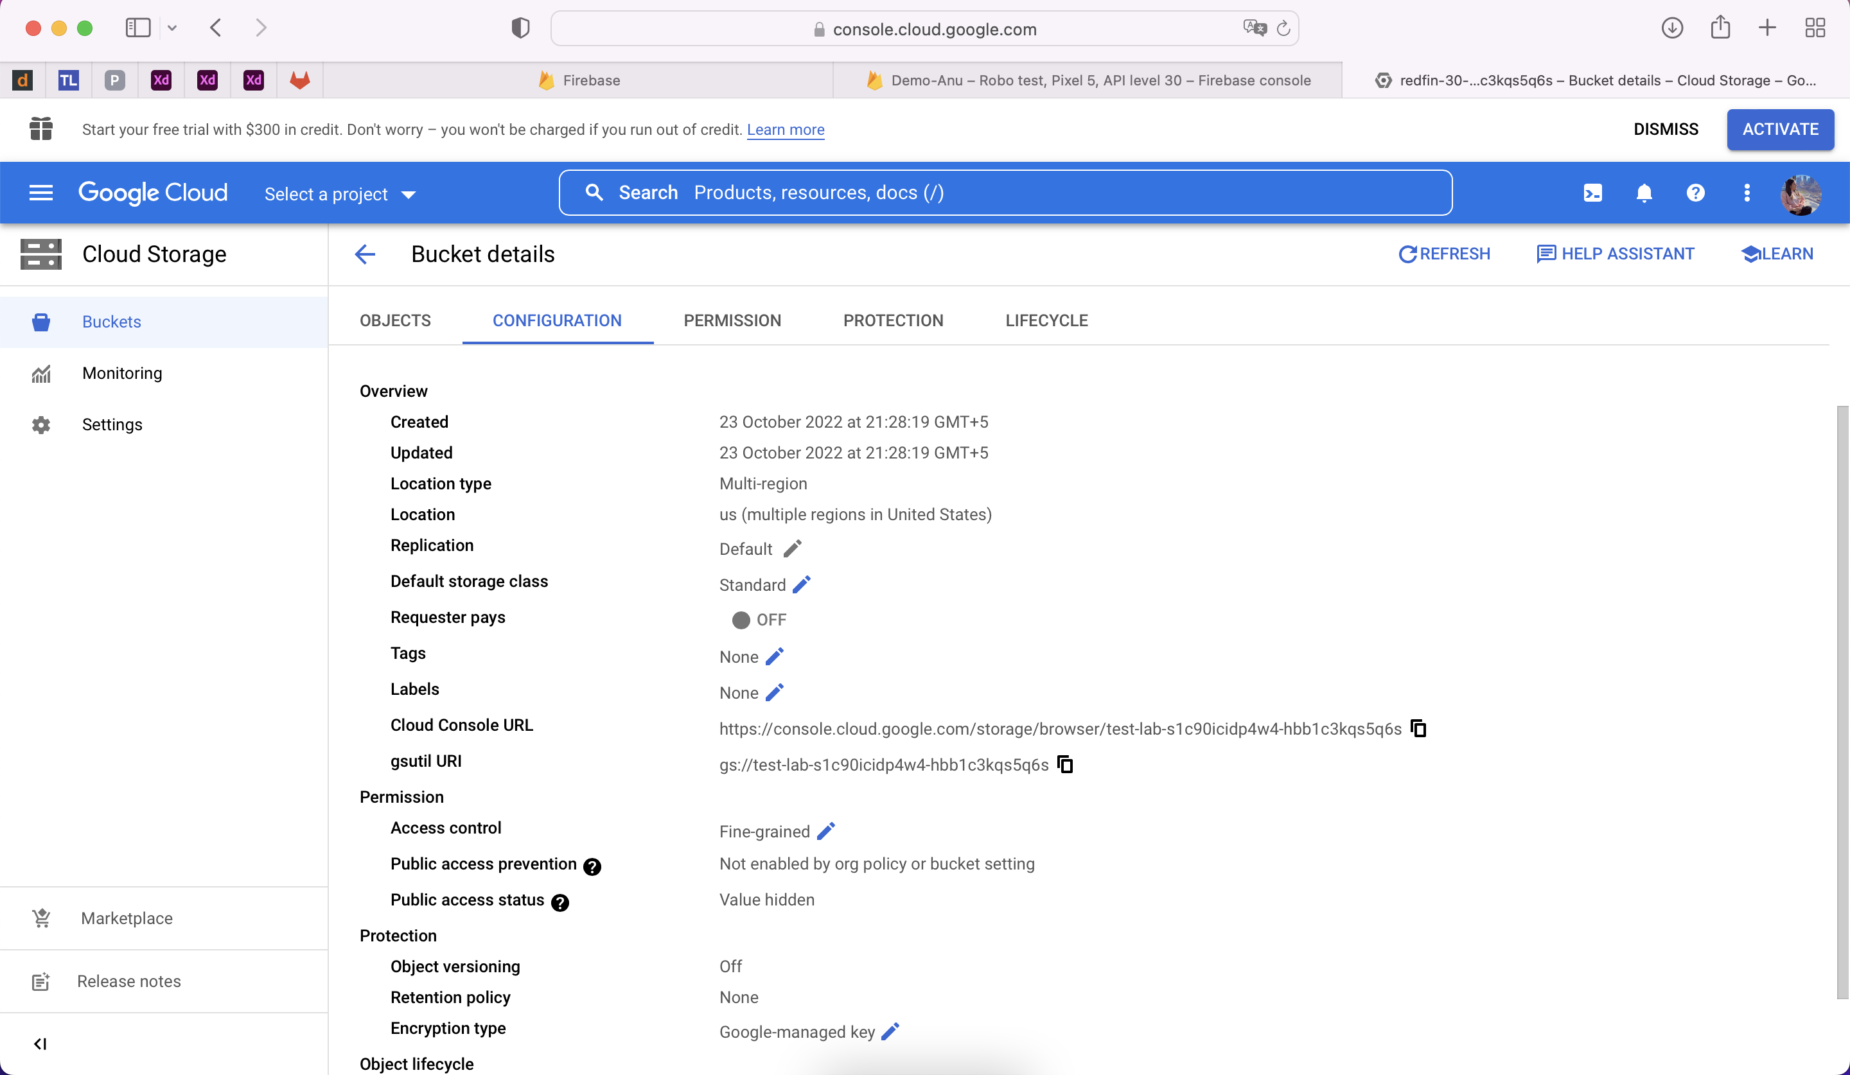
(Test Results) Project Configuration, Objects, Permission and life cycle

